Slide 1
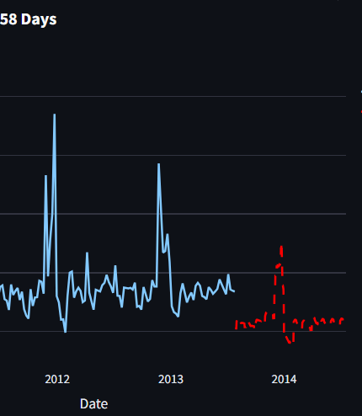

Retail Sales Forecasting
By Manas R. Das, AI Intern, OCAC
Guided By Mr. Sambit Subhasish Sahu
Notes:
Slide 1: Title
Script:
Good morning, everyone.
I’m Manas R. Das, and today,
For the Next few minutes, I’ll be presenting my machine learning project titled "Retail Sales Forecasting".
This project is an advanced, interactive dashboard solution designed for sales analysis and prediction, developed using Python and Streamlit.

Slide 2
Introduction
In the dynamic landscape of retail, understanding sales patterns and predicting future demand are critical for operational efficiency, inventory management, and strategic planning. Traditional methods often fall short in handling the complexity and volume of modern sales data. This project addresses these challenges by offering a sophisticated, interactive web-based dashboard. Leveraging the power of modern data science tools, it transforms raw sales data into actionable insights, providing a clear view of past performance and a reliable projection of future trends.

Slide 3
Objectives
Comprehensive Data Visualization
Key Performance Indicator Monitoring
Advanced Sales Forecasting
Model Interpretability
Dynamic Filtering & Customization
Model Retraining Capability
User-Friendly Interface
Notes:
Slide 2: Objective
Script:
The objective of this project is to address key challenges in retail analytics using an interactive ML-powered dashboard. Our goals include:
Visualizing historical sales using dynamic graphs,
Tracking KPIs for performance monitoring,
Forecasting future weekly sales using XGBoost,
Explaining predictions using SHAP for transparency,
Allowing custom filters by Store, Department, Season, etc.,
Enabling easy retraining with new data,
And finally, presenting everything through a user-friendly Streamlit interface.

Slide 4
Technical Specification
Navigating the future

Slide 5
Technologies & Libraries
Python
Streamlit
Pandas
NumPy
Matplotlib & Seaborn
Plotly
Scikit-learn
XGBoost
SHAP
Joblib
datetime
Notes:
Slide 3: Technical Specification
Script:
We’ve used a rich ecosystem of tools and libraries:
Python and Streamlit for development,
Pandas, NumPy, Matplotlib, and Plotly for data processing and visualization,
scikit-learn and XGBoost for model building,
SHAP for interpretability,
And Joblib for model persistence. These technologies work in sync to deliver a fast, responsive, and insightful dashboard.

Slide 6
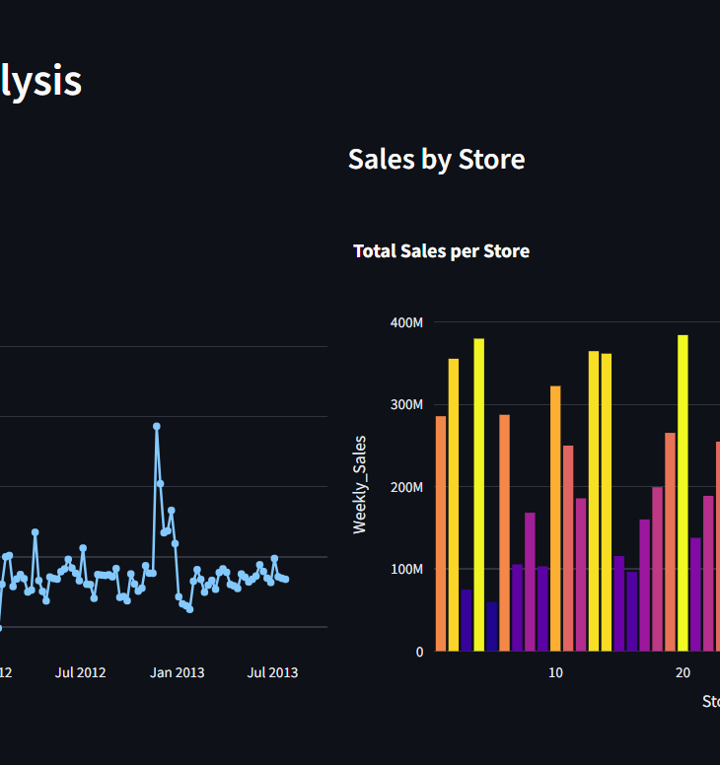
Output
Interactive Dashboard
Key-Performance Indicator
Future-Sales-Forecast Plot
Detailed Future Forecast Table
6
Notes:
Slide 5: Output
Script:
The output of the project includes:
Interactive dashboards with line, bar, pie, and box plots,
KPIs like Total Sales, Weekly Avg., Unique Stores and Depts.,
A future forecast plot for user-selected store & department,
Detailed downloadable sales tables,
And a retraining status update when new data is uploaded.

Slide 7
Outcome
Enhanced Business Intelligence
Improved Forecasting Accuracy
Optimized Inventory Management
Proactive Strategic Planning
Identification of Key Performance Drivers
Continuous Improvements
Democratization of Data Insights
7
Notes:
Slide 6: Outcome
Script:
The impact of this project includes:
Better business intelligence via visual analytics,
Higher accuracy in forecasting,
Efficient inventory planning,
Strategic planning support,
And continuous learning through on-demand retraining. Ultimately, it empowers decision-making with data.

Slide 8
Real-life Problem
Solutions
Sales Volatility
Suboptimal Inventory
Inefficient Resource Allocation
Lack of Data-Driven Decision Making
Model Obsolescence
Mitigating Sales Volatility
Optimizing Inventory
Enabling Efficient Resource Allocation
Facilitating Data-Driven Decisions
Ensuring Model Relevance
Notes:
Slide 7: Real-Life Problems
Script:
Let’s briefly look at the real-world problems we are solving:
Sales Volatility due to promotions, holidays, or external factors,
Inventory mismatch due to guesswork-based planning,
Inefficient resource allocation due to lack of foresight,
Lack of data-driven decisions, and
Model obsolescence as market trends evolve.
Slide 8: Solutions
Script:
Here's how our system addresses them:
XGBoost reduces sales volatility by considering many influencing factors,
Accurate forecasts prevent over- and under-stocking,
Future demand predictions guide staffing and logistics,
KPIs and SHAP enable explainable and data-driven decisions,
And the retraining module keeps the model up-to-date.

Slide 9
Future Scopes
More Advanced ML Model
External API Integration
User Authentication & Access Control
Database Integration
Conditional Analysis
Uncertainty Qualification
Automated Retraining & Deployment
Improved Holiday & Markdown Handing
Anomaly Detection
Customizable Dashboards
Scalability for large dataset
9
Notes:
Slide 10: Future Scope
Script:
This project opens up many possibilities:
Integrating Prophet, LSTM, or ensemble models,
API integration for real-time data (e.g., weather, social sentiment),
User authentication and access control,
Migration from CSV to databases,
What-if analysis tools,
Confidence intervals for forecasts,
Automated retraining via CI/CD,
Granular markdown and holiday logic,
Outlier detection, customizable dashboards, and
Scalability for large-scale retail datasets.
Slide 11: Conclusion
Script:
In conclusion, this project demonstrates how machine learning and modern data visualization can transform retail operations. It enables proactive planning, enhances forecasting accuracy, and ensures adaptability with retraining. It’s not just a dashboard—it’s a decision-making engine.

Slide 10
Thank you
Manas R. Das
Dept. of ECE, ABIT
Email: dasmanasranjan2005@gmail.com
Notes:
Slide 12: Thank You
Script:
Thank you for your attention. I’m open to questions and suggestions. You can reach me at dasmanasranjan2005@gmail.com.

Slide 11
QnA Time!!
Please Feel Free To Ask……………..

